Slide 1
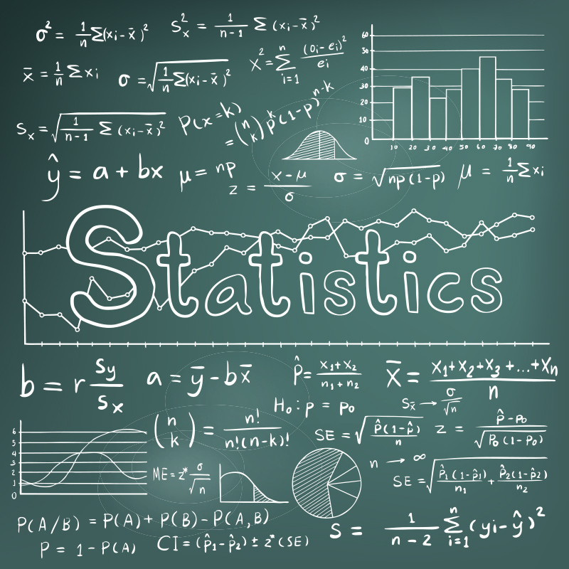
BIVARIATE DATA: SUMMARIZATION,MARGINAL AND CONDITIONAL FREQUENCY DISTRIBUTION
TEAM MEMBERS:
* VIHASHINI R
* SATHVIKA P
* RENUKADEVI R
(CSBS-’B’ SECTION)
This Photo by Unknown Author is licensed under CC BY-NC

Slide 2
BIVARIATE DATA
DEFINITION:
Bivariate data involves the analysis of two variables to determine the relationship between them.
Each value of one variable is paired with a value of the other variable.
Bivariate data is represented by ordered pairs ( x , y ).

Slide 3
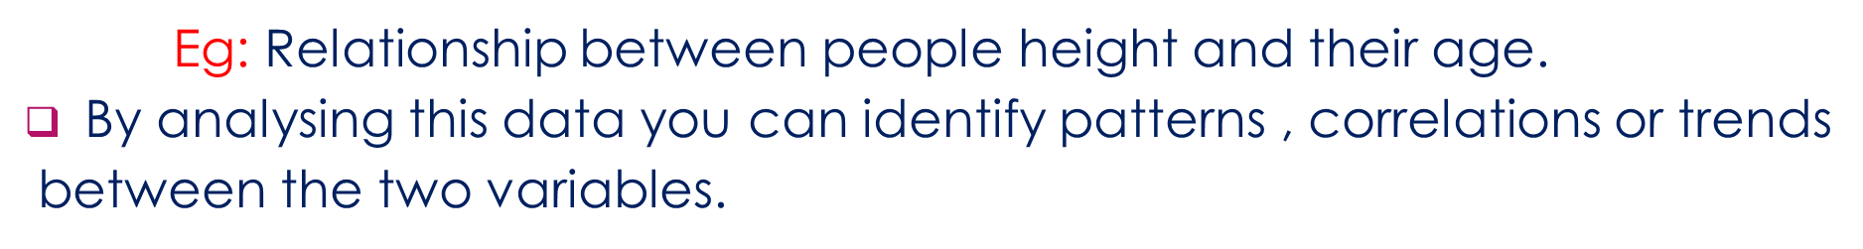
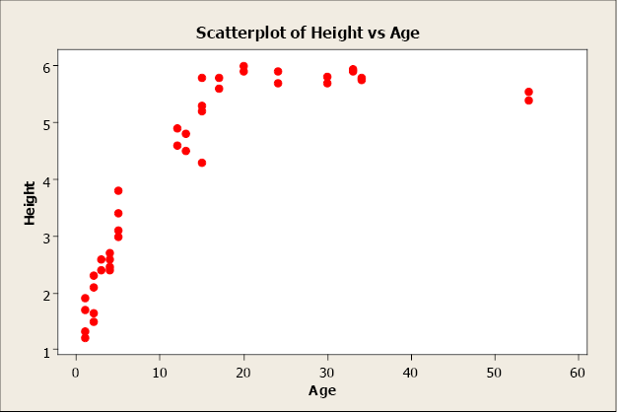

Slide 4
SUMMARIZATION
summarization involves condensing a large set of data into a few key measures that provide a comprehensive overview of the data’s main characteristics.
When a sample consists of more than one variable, descriptive statistics may be used to describe the relationship between pairs of variables.

Slide 5
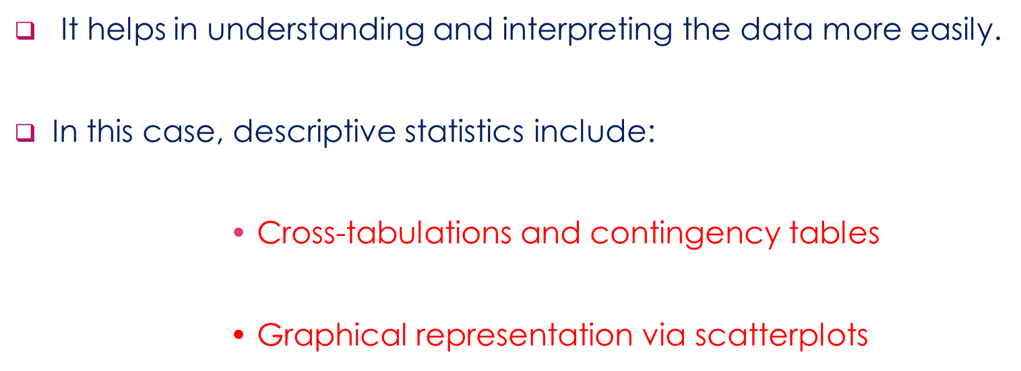

Slide 6
CROSS TABULATION AND CONTINGENCY TABLES
CROSS TABULATION:
It involves creating a table that displays the frequency distribution of variables, allowing you to see how different categories intersect and relate to each other.
In order to summarize a data, we create a two dimensional table with one variable in the rows and other variable in the columns

Slide 7
CONTINGENCY TABLES:
Contingency table is a type of table used in statistics to display the frequency distribution of variables.
It helps in understanding the relationship between two or more categorical variables by showing how the variables intersect and relate to each other.

Slide 8

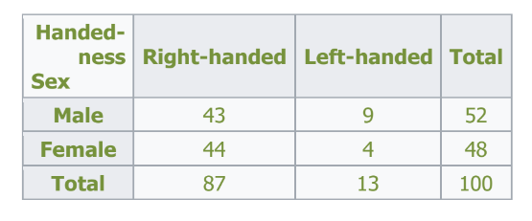

Slide 9
SCATTER DIAGRAM
It is the simplest way of the diagrammatic representation of bivariate data.
A scatter diagram, also known as a scatter plot or scattergram, is a type of graph used in statistics to display the relationship between two continuous variables
Key Features of a Scatter Diagram:
X-axis: Represents the values of the independent variable.
Y-axis: Represents the values of the dependent variable.
Data Points: Each point represents a pair of values (x, y).

Slide 10

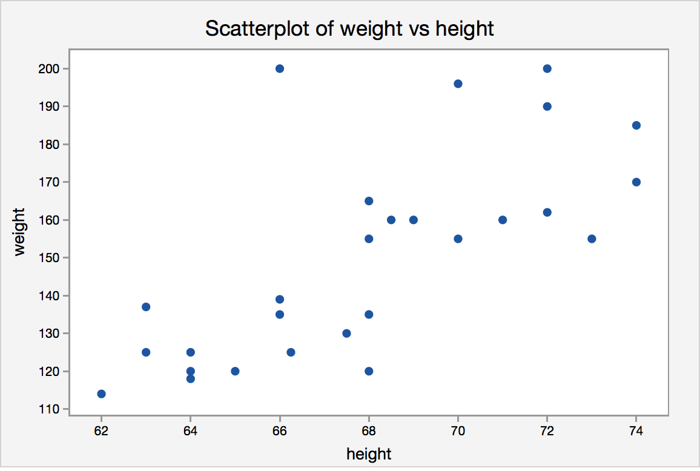

Slide 11
Marginal Frequency Distribution

Slide 12

What is actually all about the marginal frequency distribution ??

Slide 13
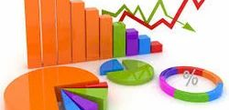
DEFINITION: Marginal Frequency Distribution is a statistical tool used to analyze the distribution of individual variables in a dataset.

Slide 14
marginal frequency distribution
Joint Frequency Distribution / Two way table
Relative Frequency Distribution
way to show how often each value occurs in a dataset, expressed as a proportion or percentage of the total number of observations.
way to show how often different values occur in a dataset, but instead of just counting the occurrences, it shows the proportion or percentage of the total number of occurrences.

Slide 15

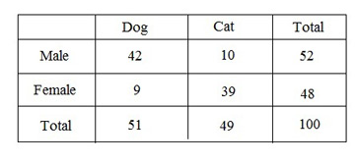
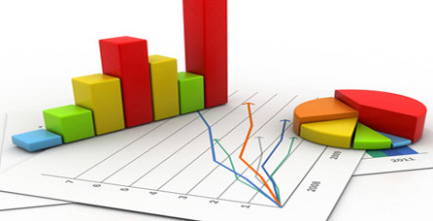
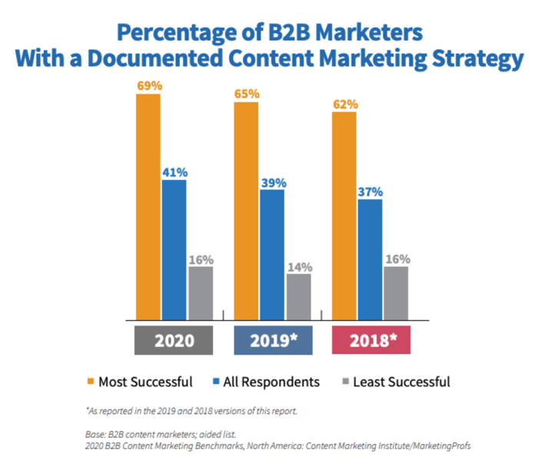
where do we use marginal frequency distribution??
Survey Data Analysis
Contingency Tables
Descriptive Statistics
Business and Marketing

Slide 16
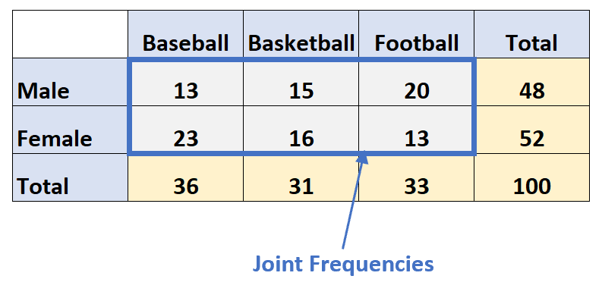
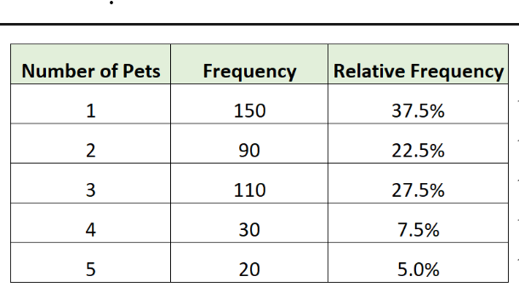
How the joint and relative frequency distribution table is represented…
Joint Frequency distribution / two-way table
Relative frequency distribution

Slide 17
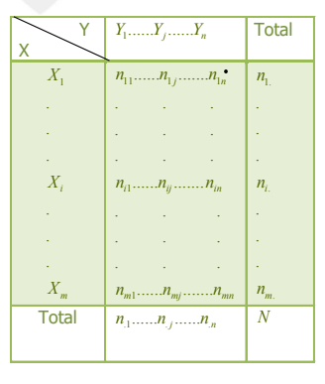
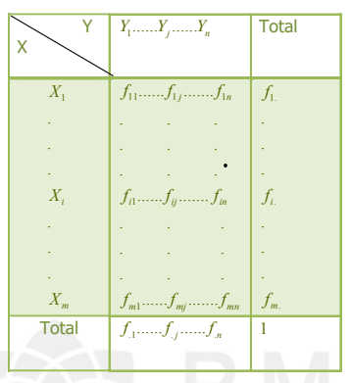
Formula :
Joint frequency distribution :
Relative joint frequency distribution:

Slide 18
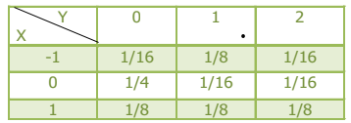

Example:
Find the marginal distribution of X and Y from the given bivariate data given below.

Slide 19
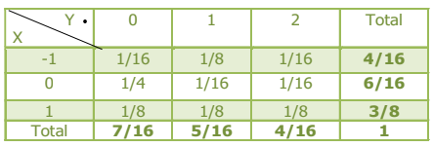
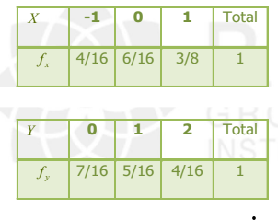
Solution :
The marginal distribution of X and Y are given by:

Slide 20


Example 2:
200 students in a middle school are asked, how they travel to school. 25 boys prefer car, 34 boys prefer bus, 41 boys prefer other transports, 22 girls prefer car, 38 girls prefer bus and 40 girls prefer other transports. Construct a two-way frequency table for the above data.

Slide 21
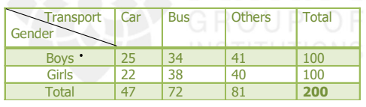
Solution :

Slide 22
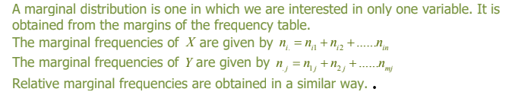
conclusion:

Slide 23
CONDITION FREQUENCY DISTRIBUTION RENUKADEVI R CSBS B’ R.M.K ENGINEERING COLLAGE

Slide 24
OBJECTIVES
1-TO estimate the frequencies of the population.
2-To facilitate the analysis of data.
3-To facilitate computation of various statistical measures

Slide 25
COMPONENTS...
1-Class
Groups according to size of data.
2-class limit
The smallest and largest possible measurements in each classes
Lower limit
Upper limit

Slide 26
3-Class mark
Also known as middle value.
4-Class interval
Upper limit – lower limit
5-Class boundaries
6-Class frequency
The number observations falling in each class.
7-Tally mark
Strokes against each frequency observed.

Slide 27
x | Frequency | Tally
10-20 | 2 | 11
20-30 | 5 | 1111
30-40 | 5 | 1111
40-50 | 4 | 1111
Class mark
½ (lower+upper)
½ (40+50)
0.5*90=45
classes
Class limit
Lower limit 40
Upper limit 50

Slide 28
Grouped frequency distribution.
based on classes,forming frequency distribution
table.
example:
From the following data construt a grouped frequency distribution.
3,8,5,2,15,16,13,12,10,19,18,11

Slide 29
Ungrouped frequency dustribution
These data’s not arranged in group,the are individual series.
It arranging in ascending order.
Example:
From the following, make a ungrouped frequency distribution.
11,12,5,3,11,13,17,13,5,5,11,5

Slide 30
11,12,5,3,11,13,17,13,5,5,11,5
x | Frequency | Tally
3 | 1 | 1
5 | 4 | 1111
11 | 3 | 111
12 | 1 | 1
13 | 2 | 11
17 | 1 | 1

Slide 31


